Slide 1


Transaction & Multi-site Transaction
SE3331-1 (2025 Fall)
IPADS, Shanghai Jiao Tong University
https://www.sjtu.edu.cn

Slide 2
Outline of today’s content
Review of OCC, its pros and cons
  And the optimization principle behind OCC
Transaction: abstraction to simplify application programming
  Especially under failure and concurrency
  Hardware + software version
A patch to OCC/2PL: multi-version (to make common case 2PL or OCC fast)
Extension of transaction to handle partial failure

Slide 3
Review: Optimistic Concurrency Control
Phase 1: Concurrent local processing
  Reads data into a read set
  Buffers writes into a write set
Phase 2: Validation serializability in critical section
  Validates whether serializability is guaranteed:
  Has any data in the read set been modified?
Phase 3: Commit the results in critical section or abort
  Aborts: aborts the transaction if validation fails
  Commits: installs the write set and commits the transaction
Goal: before or after!

Slide 4
Put it all together: OCC in an example
Tuple A in T1's read set has been changed by T2, thus T1 must be aborted.
Thread1
Thread2
T1:
B = A + B;
T2:
A = A * 1.1;
T2's read set remains unchanged, thus T2 is allowed to commit
BEGIN
BEGIN
T1's read set:
A (100)
B (100)
R(A);
R(A);
T2's read set:
A (100)
B (200)
R(B);
W(A);
T1's write set:
T2's write set:
A (110)
W(B);
Commit
Validation
Thread-local memory
Abort
Validation
Thread-local memory
Time
Database
storage
ID | Value
A | 110
B | 100
ID | Value
A | 100
B | 100

Slide 5
OCC Advantages (Using system model to analyze)
Use reads more than writes (for each read-only data access)
  OCC (in the optimal case, i.e., no abort)
    1 read to read the data value
    1 read to validate whether the value has been changed or not (as well as locked)
  2PL
    1 operation to acquire the lock (typically an atomic CAS)
    1 read to read the data value
    1 write to release the lock
      A single CPU write is atomic, no need to do the atomic CAS
Locking is costly especially compared to reads

Slide 6
Review: locking (Spin Lock) using Compare-and-swap
1 typedef struct __lock_t {
2 int flag;
3 } lock_t;
4
5 void init(lock_t *lock) {
6 // 0 indicates that lock is available, 1 that it is held
7 lock->flag = 0;
8 }
9
10 void lock(lock_t *lock) {
11 while (CompareAndSwap(&lock->flag, 0, 1) == 1)
12 ; // spin-wait (do nothing)
13 }
14
15 void unlock(lock_t *lock) {
16 lock->flag = 0;
17 }

Slide 7
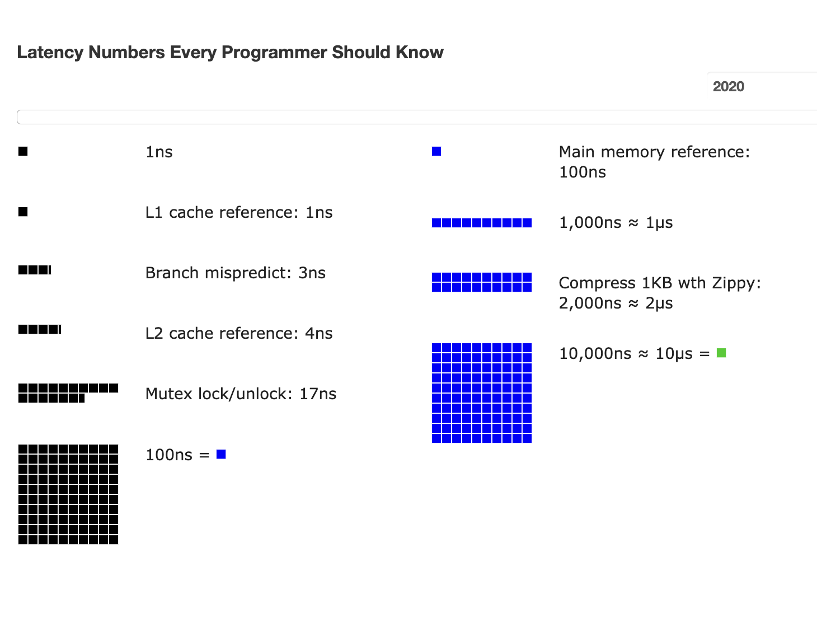
Review: Atomic operations are costly for spin lock

Slide 8
OCC's Problem: False Aborts
Some transactions aborted by OCC could have been allowed to commit without causing an unserializable schedule
Thread1
Thread2
T1:
B = A + B;
T2:
A = A * 1.1;
No cycle is formed
OCC only allows serialized execution of T2, T1, but is not able to recognize serialized execution of T1, T2.
T1 is falsely aborted
BEGIN
BEGIN
R(A);
rw
R(A);
R(B);
W(A);
W(B);
Commit
Abort

Slide 9
OCC's Problem: False Aborts & Live Lock
Some transactions aborted by OCC could have been allowed to commit without causing an unserializable schedule
Especially for TXs with a lot of reads
  E.g., read a lot of items → large read set → easier to abort
  May abort even under low-contention
Under high contention, OCC may continuously abort
  Especially with large read/write sets, or long execution time
  Transaction is executing, but no progress!
Notes:
因为执行的时间很长，所以会abort

Slide 10
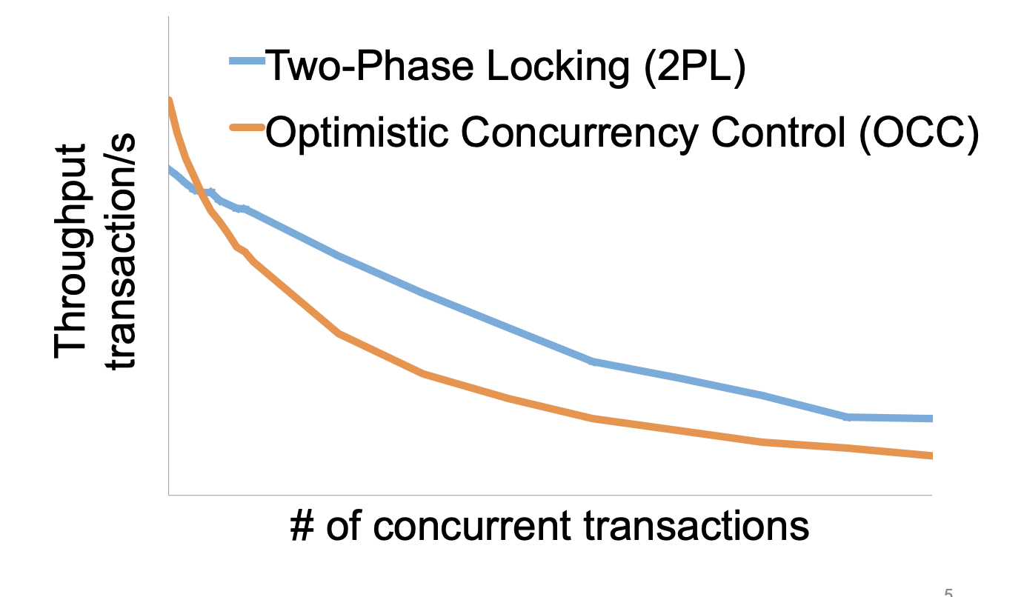
2PL vs. OCC: in a nutshell
Source: Extracting More Concurrency from Distributed Transactions [OSDI'14]

Slide 11
A short branch off: system principle behind OCC
Fast path & slow path
  Use a fast path to accelerate an operation
  Validate that the fast path matches the results
  If validation fails, goto a slow path (or using the validation results to fix the issue); otherwise, directly commit
Assumption:
  Fast path + validation is faster than the slow path
  Fast path is common

Slide 12
Case study: OCC
Fast path & slow path (Execution with 2PL)
  Use a fast path (concurrent execution w/o locks) to accelerate an operation
  Validate that the fast path matches the results (Validation or commit)
  If validation fails, goto a slow path (Re-execution) (or using the validation results to fix the issue); otherwise, directly commit
Assumption:
  Fast path + validation is faster than the slow path
  Fast path is common

Slide 13
Case study: speculative decoding in LLM inference
Context: LLM service w/ a large model (e.g., Qwen-235B)
Fast path & slow path (Generation with Qwen-235B)
  Use a fast path (generate the tokens using a small model, e.g., Qwen-30B) to accelerate an operation
  Validate that the fast path matches the results (Using batch inference to validate the sequences of tokens generated is the same as the large model)
  If validation fails, goto a slow path (or using the validation results to fix the issue) (Using the validation results as the output) ; otherwise, directly commit

Slide 14
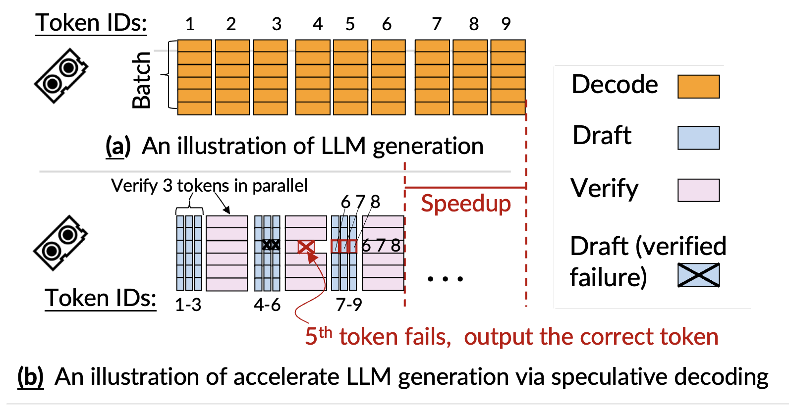
Case study: speculative decoding in LLM inference

Slide 15
Question: implementing 2PL & OCC is non-trivial, can we avoid implementing it?

Slide 16

Hardware Transactional Memory
A new CPU feature for writing multi-core concurrent programs
CPU guarantees the before-or-after atomicity of memory reads/writes
  i.e., no race conditions & (potential) no need for software-implemented2PL & OCC!
  Benefits: near zero costs if execute normally + easy to program
Intel supports HTM named as RTM
  Restricted Transactional Memory
  First released in its Haswell processor
Other implementations also exist
  E.g., ARM Transactional Memory Extension (TME)

Slide 17
A little introduction to RTM’s ISA
ISA support for transactional memory
Recall: Writing with TX is straightforward
  Use TX.begin to mark when a TX starts
  Use TX.commit to commit the TX
In RTM, the concept is similar (using new instructions)
  Use xbegin to mark an RTM execution start
  Use xend to mark an RTM end

Slide 18
Programming with RTM
If transaction starts successfully
  Do work protected by RTM, and then try to commit
Fallback routine to handle abort event
  If abort, system rollback to xbegin, return an abort code
Manually abort inside a transaction
if _xbegin() == _XBEGIN_STARTED:
if conditions:
_xabort()
critical code
_xend()
else
fallback routine

Slide 19
Programming with RTM
If an HTM transaction starts successfully
  Do work protected by RTM, and then try to commit
Fallback routine to handle abort event
  If abort, CPU rollbacks to line xbegin, return an abort code, and goto fallback
Manually abort inside a transaction
if _xbegin() == _XBEGIN_STARTED:
if conditions:
_xabort()
critical code (access x)
_xend()
else
fallback routine
Another process
x = 1

Slide 20
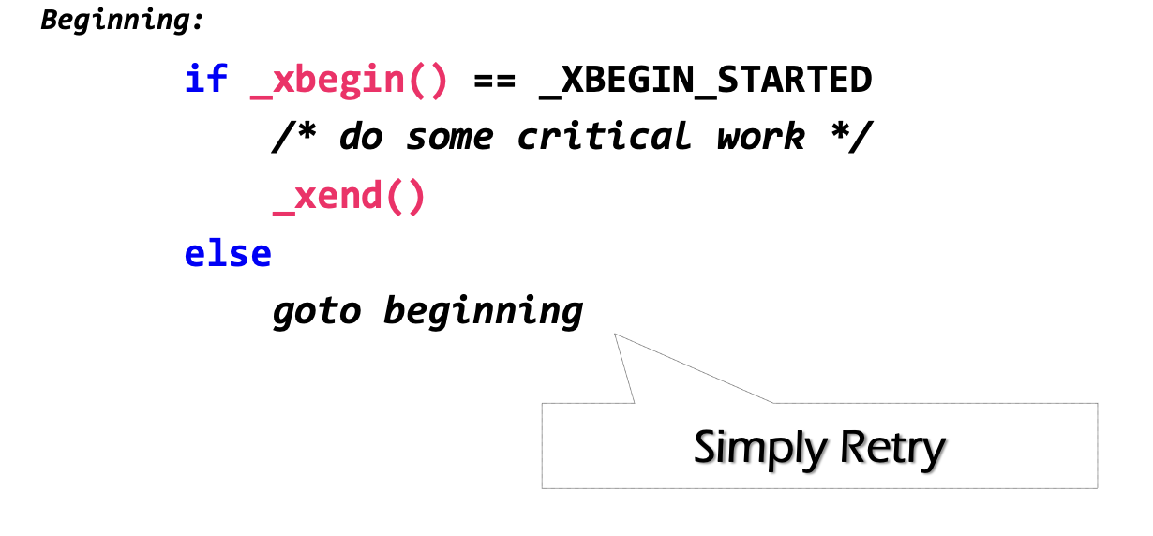
Challenge: how to handle aborts?
RTM provides new instruction set
  Key instructions: xbegin(), xend()
Problem: what if HTM aborts? How to handle it?

Slide 21
Can we use simple retry? No
Key reason: RTM cannot guarantee succeed, and in some cases, it always fails
  To see why, we need to dig into the details of OCC !

Slide 22
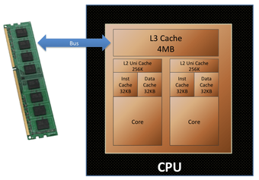
Implementation of RTM: OCC!
Background: Intel implements RTM using OCC
  Use CPU cache to track the read/write sets
  How to detect conflicts? Based on cache coherence protocols
Key to high performance

Slide 23
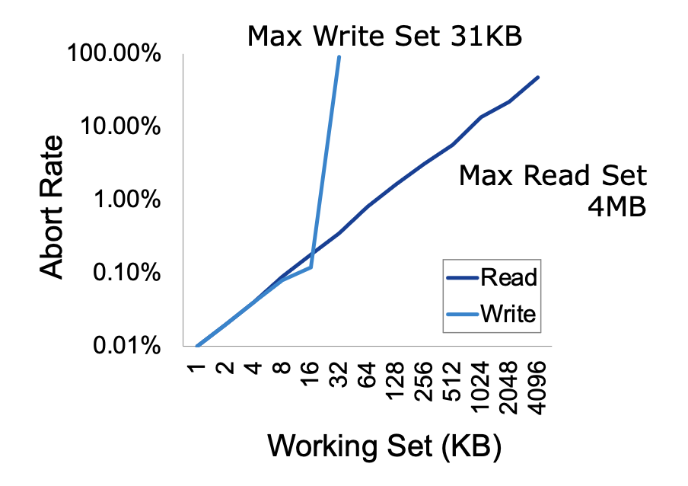
Issue#1: Limited working set
Reason: CPU has limited cache size
How big is the RTM read/write sets?
  Depends on various factors
    Hardware setup (e.g., CPU cache size)
    Access pattern: read or write
    L1 cache tracks all the writes
    L2, or L3 to tracks all the reads

Slide 24
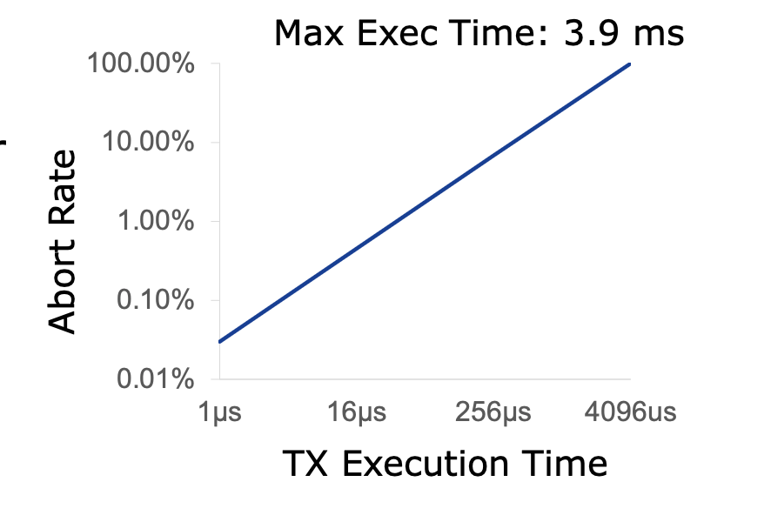
Issue#2: External events break the RTM execution
HTM TX cannot run a very long time
  The longer the execution, the higher the probability a TX aborts
Affected by external events, because cache is evicted
  Network IO, interrupt, etc.

Slide 25
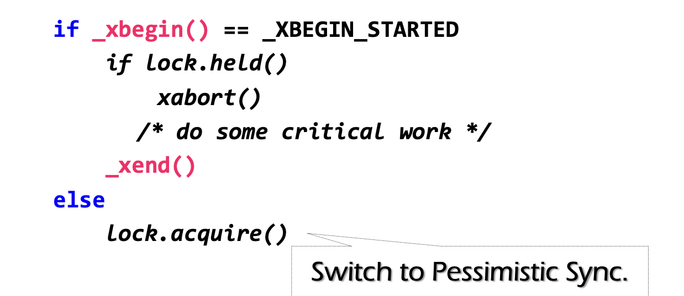
Back to our question: how to ensure progress?
Problem: RTM cannot guarantee success
  Similar to OCC, code in RTM can be frequently aborted due to conflicts
Must switch to a fallback path after some reties (e.g., using a counter)
  E.g., degrade to use lock in the fallback path; typically use global locking to simplify coding
check lock status to avoid conflict with fallback handlers on other CPU

Slide 26
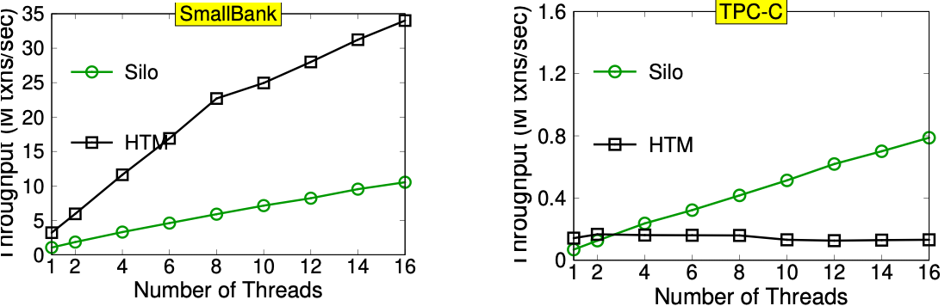
Hardware vs. Software-based OCC
Naïve: using HTM to execute the in-memory transaction
  Smallbank: transfer &. Audit
  TPC-C: much complex, insert 10+ orders and update 10+ stocks
Silo@SOSP’13: the fastest in-memory OCC implementation

Slide 27
Short summary of HTM
Hardware support for transactional memory
  Easy programming model for the programmer (no need to wrap transaction in read/write API of the transaction)
    As long as the programmer do the in-memory computations, e.g., in-memory database
  Good performance if using properly
    No need for locking & atomic operations
  However, the programmer should handle its pitfalls
It is an application of OCC (in the hardware)
  OCC is a general technique that can be applied to many fields

Slide 28
Transactions: an abstraction to simplify achieving atomicity

Slide 29

Widely used transaction (TX)s
Caching server
Caching server
…
Caching server
All can use TX to manager data!
  e.g., FS meta data
Caching
Caching
Caching
Distributed caching
Database server
Database server
CDN
Users
Application #1
generate the page
Database
user, price
…
Database
user, price
Application server
Distributed database
Internet
Load
Balance
Application #2
add the order
File server
File server
File server
File:
image
File:
image
…
File:
image
Application server
…
…
Message queue
Distributed file system

Slide 30

Widely used transaction (TX)s
if item.count > 0:
item.count -= 1
Cart.add(item)

Slide 31


Widely used transaction (TX)s
Why financial applications are typically implemented by TXs?

Slide 32
What is a transaction?
An abstraction to manage the data
Data is also an abstract concept, can be arbitrary computing data. Concrete examples including:
  Key-value store entries
  File system metadata (e.g., directory,, inode, etc)
  Processor’s metadata (e.g., child processors)
Look like similar program, with data managed by the TX system, and extra mark to denote the start/end of a TX

Slide 33
TX: an abstraction to ease data management
Writing with TX is straightforward, the atomicity is left to the system
  Use TX.begin to mark when a TX starts
  Use TX.commit to commit the TX
  Rewrite the data read/write with TX’s interface
    E.g., bank[a] = bank[a] – amt
    tx.write(a, tx.read(a) – amt);
transfer(bank, a, b, amt, tx):
tx.begin()
tx.write(b, tx.read(b) + amt);
tx.write(a, tx.read(a) – amt);
tx.commit()
transfer(bank, a, b, amt):
bank[b] = bank[b] + amt
bank[a] = bank[a] - amt
Program
Transaction

Slide 34

What is special of TX? It provides ACID
The program btw { tx.begin() & tx.commit() } has the following properties:
A：Atomicity
C：Consistency
I：Isolation
D：Durability
...
tx.begin();
...
...
tx.commit();
...
ACID
Application program

Slide 35

Atomicity: All-or-nothing

Slide 36
Isolation & Durability
Atomicity: the transactions’ modification is all-or-nothing
Isolation: Two concurrently transactions are isolated (Before-or-after)
  E.g., not viewing the intermediate results of another TX
  Avoid the race conditions
Durability
  Once a transaction is committed, its changes (e.g., writes) must durably stored to a persistent storage

Slide 37
Question: we motivate the atomicity with consistency, but what does the consistency in TX here mean?

Slide 38
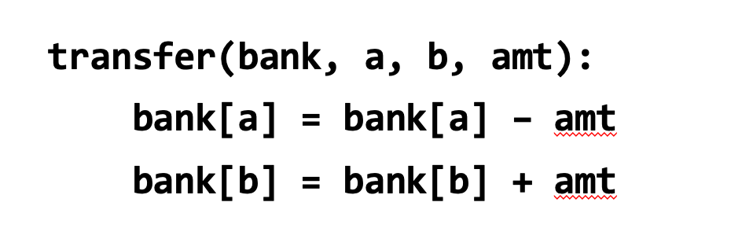
Consistency
Transaction must change the data from a consistent state to another
  What is consistent is defined by the applications
  E.g., transfer should leave the sum(bank[a] + bank[b]) unchanged
Atomicity (all-or-nothing + before-or-after) alone is not sufficient for application consistency
  E.g., If the programmer writes the incorrect program.
    bank[a] = bank[a] - amt * 2

Slide 39
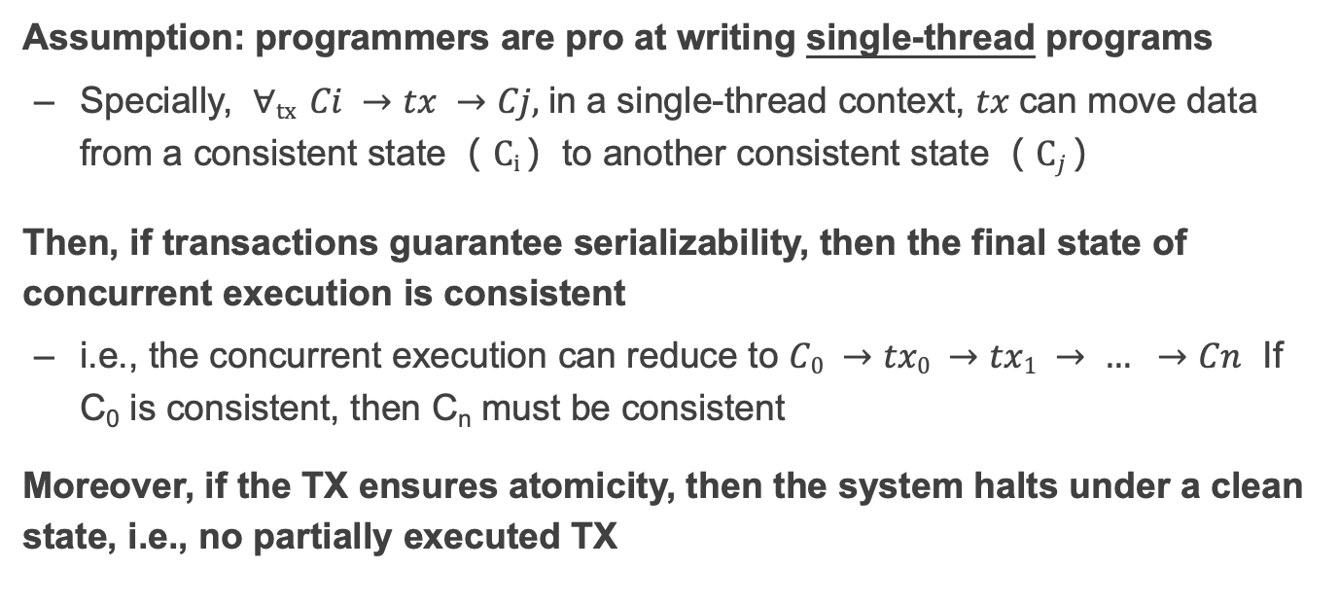
Why atomicity + isolation is still closely related to consistency?
Assumption: programmers are pro at writing single-thread programs
  Specially, $∀tx Ci →tx →Cj,$in a single-thread context, $tx$can move data from a consistent state（ $Ci$）to another consistent state（ $Cj$）
Then, if transactions guarantee serializability, then the final state of concurrent execution is consistent
  i.e., the concurrent execution can reduce to $C0 →tx0 →tx1 → … →Cn$ If C₀ is consistent, then C_{n} must be consistent
Moreover, if the TX ensures atomicity, then the system halts under a clean state, i.e., no partially executed TX

Slide 40
Remaining question: can TX be implemented efficiently?
The challenge lies in supporting isolation.

Slide 41
Review: 2PL vs. OCC: in a nutshell
Goal
Source: Extracting More Concurrency from Distributed Transactions [OSDI'14]

Slide 42
Next: for specific cases, we can achieve high-performance isolation!

Slide 43

Motivation: TX usage in real-world application
Scenario: long-running read-only or read-mostly transactions is common
  e.g., for Taobao, we rarely buy items, but extensively read the items
Question: can 2PL or OCC efficiently supports such transactions?
  E.g., a TX reading a lot of items
2PL: deadlock + locking overhead
OCC: aborts due to validation failures
Question: can we avoid so?
Notes:
因为执行的时间很长，所以会abort

Slide 44
Example: can we avoid aborts due to validation failures in OCC?

Slide 45

Abort in OCC
T1:
Print(A+B)
T2:
B = 2
A = 3
Time
T1
T2
Read(A_{T0})
Read(B_{T0})
Write(A_{T2})
Write(B_{T2})
Validate(A)
Abort!

Slide 46
Abort in OCC
T1:
Print(A+B)
T2:
B = 2
A = 3
Time
T1
T2
Read(A_{T0})
Read(B_{T0})
Do we necessarily need to abort T1?
Write(A_{T0})
Write(B_{T2})
Validate(A)
Abort!

Slide 47
Abort in OCC case (2)
T1:
Print(A+B)
T2:
B = 2
A = 3
Time
T1
T2
Read(A_{T0})
Write(A_{T2})
Write(B_{T2})
Read(B_{T2})
Validate(A)
Question: can we avoid aborting T1?
Abort!

Slide 48
Abort in OCC case (2)
T1:
Print(A+B)
T2:
B = 2
A = 3
Time
T1
T2
Read(A_{T0})
Write(A_{T2})
Write(B_{T2})
Read(B_{T0})
Read(B_{T2})
Overwrite

Slide 49
Idea: multi-versioning concurrency control
Each data has multiple-versions instead of a single version
  A set of version represents a snapshot of the database
    E.g., A_{T0} + B_{T0}
  The version ~= the time a TX makes the updates
Data
VersionedData
X₀
X₁
X
Struct Data {
value : u8[…]
lock : lock_t
}
Struct Data {
value: List<VersionedData>
lock : lock_t
}
Struct VersionedData {
value: u8[…]
version: u64
}

Slide 50
Idea: multi-versioning concurrency control
Read
  Only read from a consistent snapshot at a start time
Write
  Install a new version of the data instead of overwriting the existing one
  Version ~= the commit time of the TX
Goal: avoid race conditions on reading a snapshot
Data
VersionedData
X₀
X₁
X
Struct Data {
value : u8[…]
lock : lock_t
}
Struct Data {
value: List<VersionedData>
lock : lock_t
}
Struct VersionedData {
value: u8[…]
version: u64
}

Slide 51
Get the start and commit time
Requirement: the counter reflects TX’s serial execution order
  E.g., if T1 finishes before T2, it will have a smaller start & commit timestamp
  Not necessary for read-only TX, but is critical for the write
Simplest (& most widely used) solution: global counter
  Using atomic fetch and add (FAA) to get at the TX’s begin & commit time
  TX Begin: use FAA to get the start time
  TX Commit: use FAA to get the commit time
Not using a global counter is challenging because de-centralized time (e.g., physical time) is unsynchronized

Slide 52
Try #1: Optimize OCC w/ MV (incomplete)
Acquire the start time
Phase 1: Concurrent local processing
  Reads data belongs to the snapshot closest to the start time
  Buffers writes into a write set
Acquire the commit time
Phase 2: Commit the results in critical section
  Commits: installs the write set with the commit time
Compared to the OCC, no validation is need!

Slide 53
Try #1: Optimize OCC w/ MV (incomplete)
Commit(tx):
for record in tx.write_set:
lock(record)
let commit_ts = FAA(global_counter)
for record in tx.write_set:
record.insert_new_version(commit_ts, ...)
unlock(record)
Get(tx, record):
while record.is_locked():
pass
for version,value in record.sort_version_in_decreasing():
if version <= tx.start_time:
return value

Slide 54
Partial snapshot
T2:
B = 2
A = 3
T1:
Print(A+B)
Global counter g (initial 0)
T1
T2
1
Start_time = FAA(g)
A: A₀
B: B₀
Read(A) = A₀
2
Commit_time = FAA(g)
Write(B, B₂)
A: A₀
Read(B) = B₀
B: B₂ B₀
Write(A, A₂)
A: A₂ A₀
B: B₂ B₀
No validation needs here (for T1) !
Problem: partial updated snapshot

Slide 55
Partial snapshot example
T1:
Print(A+B)
T2:
B = 2
A = 3
Global counter (initial 0)
T1
T2
Needs to be atomic
A: A₀
1
Commit_time = FAA(g)
B: B₀
Write(B, B₁)
A: A₀
2
start_time = FAA(g)
B: B₁ B₀
Read(A) = A₀
Read(B) = B₁
A: A₁ A₀
Write(A, A₁)
B: B₁ B₀
Missing the updates! We need T2’s write being before-or-after atomic!

Slide 56
Enforcing the write atomicity of snapshot w/ locking
Commit(tx):
for record in tx.write_set:
lock(record)
let commit_ts = FAA(global_counter)
for record in tx.write_set:
record.insert_new_version(commit_ts, ...)
unlock(record)
Get(tx, record):
while record.is_locked():
pass
for version,value in record.sort_version_in_decreasing():
if version <= tx.start_time:
return value

Slide 57
Example revisit
T1:
Print(A+B)
T2:
B = 2
A = 3
Question: can we reorder get commit time and locking?
Global counter (initial 0)
T1
T2
Lock A, B
A: A₀
1
Commit_time = FAA(g)
B: B₀
Write(B, B₁)
Unlock B
A: A₀
2
start_time = FAA(g)
B: B₁ B₀
Read(A) = ?
A: A₀
Cannot read! Because A is locked!
B: B₁ B₀
A: A₁ A₀
Write(A, A₁)
B: B₁ B₀
Unlock A
Read(A) = A₁
Read(B) = B₁

Slide 58
What about writes?
T1:
A += 1
T2:
A += 1
Global counter (initial 0)
T1
T2
1
Start_time = FAA(g)
Read(A₀) = 0
2
Start_time = FAA(g)
Read(A₀) = 0
3
Commit_time = FAA(g)
Write (A_{3,} 1)
4
Commit_time = FAA(g)
Write (A_{4,} 1)

Slide 59
MVCC ensures no race for reads, but not writes
Race conditions of reads are isolated via snapshots
But we still needs to rule out race conditions between reads + writes
  We do so by validating the writes at the commit time
The validation is simple:
  During commit time, check whether another TX has installed a new snapshot after the committing TX’s start time

Slide 60
Put it together, MVCC so far
T is assigned a commit timestamp T.cts
System checks all data within T.wset,
if T.sts < X.cts, then abort T
Update all data within T.wset with T.cts
T is assigned a start timestamp T.sts
T
START
READ(X)
WRITE(X)
COMMIT
Time
T reads the biggest version of X(i), such that X(i).cts <= T.sts
T buffers writes to X and adds X to its write-set, T.wset += {X}

Slide 61
Question: do our current MVCC method guarantee before-or-after?

Slide 62
Write skew anomaly
Our MVCC differs from serializability due to one anomaly
Describe the anomaly and also give a concrete application for which the anomaly is undesirable.
T1
S
R(X)
W(Y)
C
R(X) = X₀
W(Y) = Y₂
T2
S
R(Y)
W(X)
C
R(Y) = Y₀
W(X) = X₁
Possible Conflict Serial Order
X₀
X₁
T1
T2
Y₀
Y₂
T2
T1

Slide 63
Fixing the anomaly
The simplest way is to validate the read-set in read-write TX
  Essentially fallbacks to OCC for read-write TX
  But read-only TX can still enjoy the benefits from MVCC
    Never aborts & no validations
Usually being ignored in practice (Snapshot isolation)
  The MVCC without the read validation is also called snapshot isolation (SI)
Though the idea of MVCC is first proposed in SI, its usage is not restricted to it, e.g., we can have MV-2PL and MV-OCC; & we will see it later

Slide 64
Summary so far
Review of OCC, its pros and cons
  And the optimization principle behind OCC
Transaction: abstraction to simplify application programming
  Especially under failure and concurrency
  Hardware + software version
A final patch to OCC/2PL: multi-version (to make common case 2PL or OCC fast)
Extension of transaction to handle partial failure

Slide 65
Multi-site transaction &
Multi-site atomicity: handling failures under scaled-out TX

Slide 66



Multi-site transaction: what if the data is distributed?
The data accessed by TXs are stored on multiple machines
  i.e., a single site cannot store all the bank accounts
The setup
  Client + coordinator + two servers
  One server handles bank accounts A-M
  The other server handles bank accounts N-Z
  Coordinator and servers all have logs to ensure single transaction atomicity
Coordinators
e.g., frontend servers
Storage servers
e.g., key-value stores
Clients,
e.g., iPhone
A - M
N - Z

Slide 67

Deposit(bank, a, amt):
bank[a] += amt
Multi-site transaction
e.g., coordinator sends multiple deposit to different servers
  They use RPCs to send requests to the server to execute transaction
发工资(bank, accts, amt):
for acct in accts:
deposit(bank, acct, amt)
发工资
Coordinator
Server 0
deposit(“Alice”)
Audit(“Zack”)
Server 1
Time

Slide 68
Multi-site transaction
Coordinator sends multiple deposit to different servers
  They use RPCs to send requests to the server to execute transaction
发工资(bank, accts, amt):
for acct in accts:
deposit(bank, acct, amt)
发工资
Coordinator
Server 0
deposit(“Alice”)
deposit(“Zack”)
Server 1
Time
What if one server commits and the other aborts?

Slide 69
Goal: all sites either all commits or all aborts
Under partial failure!

Slide 70
Two-phase Commit: a way to ensure multi-site atomicity
High-layer TX
  The high-level view of the TX
Low-layer TX
  Specific reads and writes that executed on a single machine
Higher-layer transaction coordinates the execution of lower-layer TXs
  All low-layer TX either all commits or all aborts
发工资(bank, accts, amt):
tx.high_begin()
for acct in accts:
deposit(bank, acct, amt)
tx.high_commit()
High-layer TX
Deposit(bank, a, amt):
tx.low_begin()
bank[a] += amt
tx.low_commit()
Low-layer TX

Slide 71
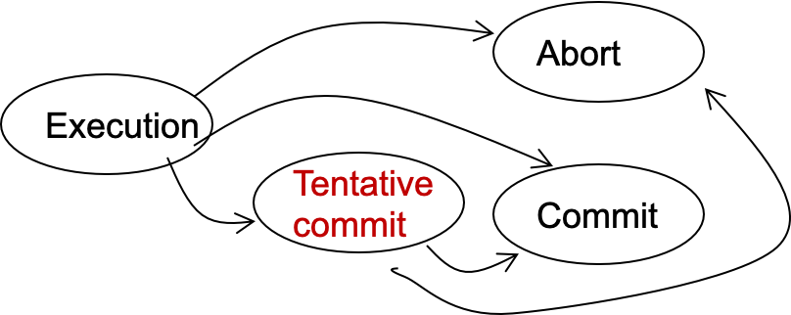
Two-phase Commit: a way to ensure multi-site atomicity
Phase-1: preparation / voting
  Delay the commitment of low-layer TXs
  Lower-layer transactions either abort or tentatively committed
  Higher-layer transaction evaluate lower situation
Phase-2: commitment
  The high-layer decides whether low-layer TXs will commit or abort
  It will also coordinate the commitment of lower-layer TXs
State transitions of a TX
Notes:
Why 2 phase? Delay the commitment of TX

Slide 72
Two-phase Commit: a way to ensure multi-site atomicity
Goal: all lower-TX either all commits, or all aborts
How to achieve so?
  Simple: if all lower-TXs is tentatively committed, then commit the high TX
Notes:
Why 2 phase? Delay the commitment of TX

Slide 73
Two-phase Commit: a way to ensure multi-site atomicity
High-layer TX
发工资(bank, accts, amt):
tx.high_begin()
for acct in accts:
deposit(bank, acct, amt)
tx.high_commit()
High_begin
  Mark itself as a high-level transaction
High_commit
  Send prepare messages to the low-level transactions to check whether it can commit
tx.high_begin()
tx.high_commit()
for each deposit:
if deposit.abort: abort()
for each deposit:
deposit.commit()
Deposit(…)
Deposit(…)
Time

Slide 74
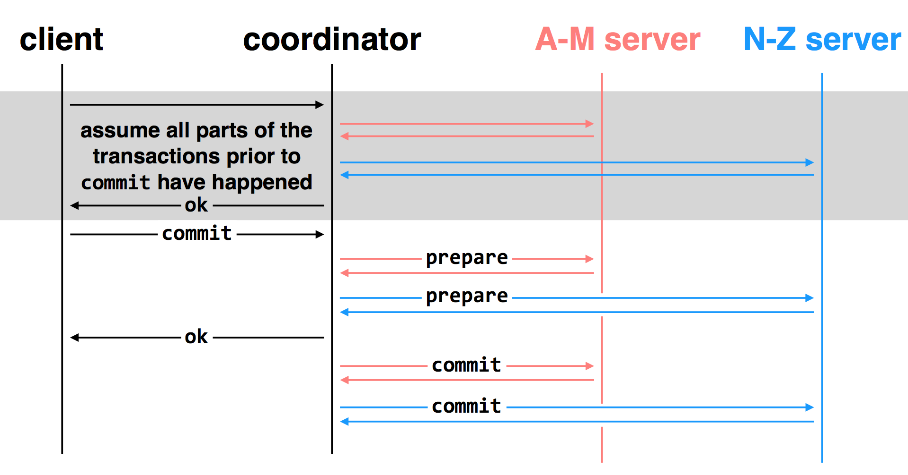
Multi-site transactions under two-phase commit
Idea: the coordinator is responsible for committing all the TXs
    By sending RPCs or Messages to all the other servers

Slide 75
Challenge: unreliable communications, coordinator & worker

Slide 76
Multiple-site Atomicity
Principles:
  Following the coordinator’s decision
  Log sufficient state to tolerate failures (e.g., the coordinator’s decision)
Coordinator (do the decision & maintain the state)
  Collect some ABORT or nothing: ABORT or retry
  Collect all COMMIT: then COMMIT
Worker passively react to the coordinator’s actions
  If no message is sent from the coordinator, just wait
  When receive COMMIT: then COMMIT

Slide 77
Logging rule of WAL under 2PC
Low-layer transaction
  REDO-UNDO log entries: like normal
  Commit log entry -> Tentative commit log entry (PREPARED)
    Contains a reference to the high-layer TX
    In case of failure: ask the high-layer TX’s coordinator to see if I can commit
High-layer transaction （Responsible for commit of low-layer TXs)
  Log the prepare log as a commitment of a high-layer TX

Slide 78
client
coordinator
A-M server
N-Z server
assume all parts of the transactions prior to
commit have happened
OK
commit
prepare
prepare
OK
commit
commit
two-phase commit: nodes agree that they are ready to commit before committing

Slide 79
client
coordinator
A-M server
N-Z server
OK
commit
X
prepare
timeout; resend
prepare
prepare
OK
commit
commit
failure: lost prepare

Slide 80
client
coordinator
A-M server
N-Z server
OK
commit
prepare
X
timeout; resend
prepare
prepare
OK
failure: lost ACK for prepare

Slide 81

client
coordinator
A-M server
N-Z server
OK
commit
prepare
prepare
abort
abort
failure: worker failure during prepare
coordinator can safely abort transaction, will send explicit abort messages to live workers

Slide 82
client
coordinator
A-M server
N-Z server
OK
commit
prepare
prepare
OK
commit
X
Why? Just wait..
tx?
timeout; resend
commit
commit
failure: lost commit message

Slide 83
client
coordinator
A-M server
N-Z server
OK
commit
prepare
prepare
OK
commit
X
timeout; resend
commit
commit
failure: lost ACK of commit message

Slide 84

client
coordinator
A-M server
N-Z server
OK
commit
prepare
prepare
OK
commit
commit
failure: worker failure during commit
Notes:
workers write PREPARE records once prepared. the recovery process — reading through the log — will indicate which transactions are prepared but not committed

Slide 85

client
coordinator
A-M server
N-Z server
OK
commit
prepare
prepare
OK
commit
commit
tx?
restart
commit
failure: worker failure during commit

Slide 86

client
coordinator
A-M server
N-Z server
OK
commit
prepare
coordinator recovers
abort
abort
failure: coordinator failure during prepare

Slide 87
client
coordinator
A-M server
N-Z server
OK
commit
prepare
prepare
OK
commit
coordinator recovers
commit
commit
failure: coordinator failure during commit
Must log the decision before sending the commit messages

Slide 88
What about 2PL or OCC in 2PC?
Nearly identical
  2PL: each low-layer TX cannot release its lock until the high-layer TX decides to commit
  OCC: the validation & commit phases are done by the coordinator

Slide 89
Summary of 2-phase Commit
Two-phase commit allows us to achieve multi-site atomicity: transaction remains atomic even when they require communication with multiple machines
In two-phase commit, failures prior to the commit point can be aborted. If workers (or the coordinator) fail after the commit point, they recover into the PREPARED state, and complete the transaction
Remaining challenge: availability under coordinator failures
  Follow the coordinator’s decision simplifies achieving multi-site atomicity, but what if the coordinator crashes for a long time?
  We will see how to make the coordinator available in the next lecture

